Slide 1
‘BLUEPRINTS 4 SUCCESS’
Stephen Drake

Slide 2
INTERESTING
LEARN SOMETHING
HAVE SOME FUN

Slide 3
My name is
Stephen Drake
I take the confusion out of goal setting, giving you the tools, you need to get the results you want.
Ready to get started?

Slide 4
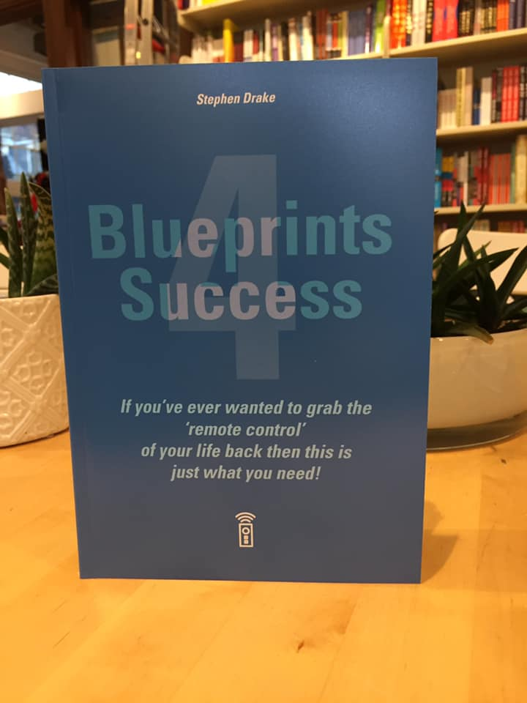
Published November 2019
Think of it as not needing to know everything about electricity to turn the light on.
You just need to learn to flick the switch.

Slide 5

Rest assured. I am not here to sell you a book.

Slide 6


Slide 7
2024
New Year, Leap Year, Olympic Year … Your Year?

Slide 8
New Year’s Resolution Statistics
Overall success/failure rates

Slide 9
The Most Popular Resolutions
Year after year, being healthier is consistently the most popular New Year’s resolution across the globe, whether that’s eating healthier, exercising more, or losing weight.
Saving money is the next most popular resolution.

Slide 10
Researchers suggest that only 9% of people that make resolutions complete them.
In fact, research goes on to show that 23% of people quit their resolution by the end of the first week, and 43% quit by the end of January.
.

Slide 11


Slide 12
Reasons for failure
In one study, 35% of participants who failed their New Year’s Resolutions said they had unrealistic goals.
33% of participants who failed didn’t keep track of their progress.
23% forgot about their resolutions.
About one in 10 people who failed said they made too many resolutions.

Slide 13
What to know the real culprit?
A lack of proper mental preparation.

Slide 14
MINDSET
Probably the biggest obstacle that any individual must overcome is 'MINDSET'.
Words, Pictures & images going through their own mind at any given time.
There are two people we find over the course of a lifetime.
Number 1 - The individual who can see exactly what he or she wants, and Number 2 - The individual who only see's the obstacles that block him or her from getting what they want.

Slide 15
Mindset is something I have been interested in learning more about for a long time.
And when I say a long time.

Slide 16
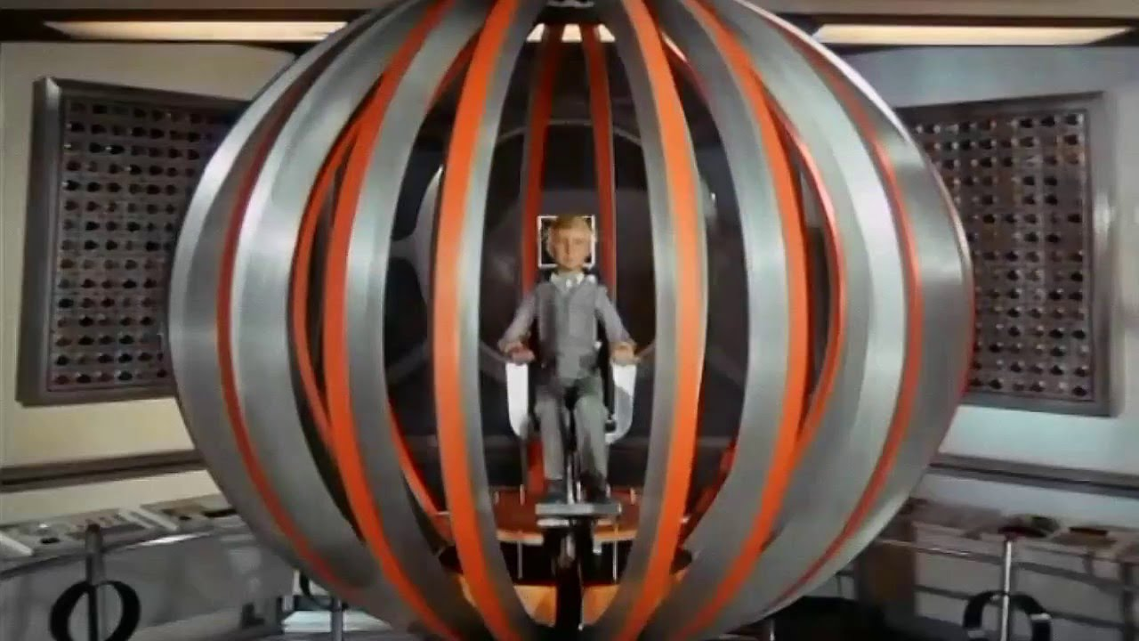

Slide 17
WHO REMEMBERS
JOE 90?

Slide 18
In the Gerry Anderson puppet series "Joe 90," the R.A.T. (or "Random Access Talent") was the device that allowed the main character, Joe McClaine, to acquire the knowledge and skills of another person by directly downloading them into his brain.
That idea is not as farfetched as you would first imagine

Slide 19
Today, you can draw parallels with modern ideas about mindset, belief, and affirmations. Imagine a special technology or process that helps individuals adopt the mindset, skills, and beliefs of successful people in specific areas.
It's like a mental upgrade that allows someone to temporarily absorb the knowledge and abilities of others.

Slide 20
How would Joe 90 go about achieving his new year's resolution?
Strategy: - A plan of action or policy. A definable, repeatable formula from getting from point ‘A’ to point ‘B’

Slide 21
Sleeping Strategy Model
Slow down breathing pattern
Slow down internal Dialogue
Slow down Physiology
You pretend to be asleep for a few minutes

Slide 22
Modelling the state
You wish to enter

Slide 23
Act ‘As if’
"Act As If"
is a strategy that encourages individuals to consciously adopt the mindset of the person they aspire to become, even when faced with self-doubt or challenging circumstances.

Slide 24

Clock Face exercise
An exercise in self-belief. What happens when we start something without a clear goal in mind? How to visualize goals, what they look, feel and sound like. How the subconscious responds to this visualization.

Slide 25
Let’s now look at how easily the subconscious can be guided.
Why many of the beliefs we have about ourselves that limit our performance, when examined closely and honestly, are untrue, untested and self-imposed?
That when you examine these limiting beliefs and decide to do something about it you free yourself to expand your comfort zone further, learning new abilities and experiencing more.
If you are going to believe stuff that’s not true, then believe good stuff!

Slide 26
The Reticular Activating System
Whatever you focus on becomes your reality.
When you change your focus, you change your reality.
The blue room, an exercise in how the R.A.S affects us every day.
How to set your R.A.S. with questions.
The power of questions, how your brain is designed to give you an answer to every question you ask it good or bad.

Slide 27
Everyone is talking about A.I.
I don’t think we have finished with H.T
HUMAN TECHNOLOGY

Slide 28
I did say at the start of my presentation that I hoped you found my talk ‘Interesting’ while learning something (about yourself)
AND I PROMISED TO DELIVER YOU SOME FUN

Slide 29

LET’S CONNECT

Slide 30


